Slide 1
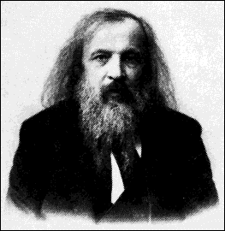
History of the Periodic Table
Russian chemist Dmitri Mendeleev (1869) wanted to organize known elements by properties.
When he arranged elements by increasing atomic weights, he noticed that similar elements occurred at regular intervals.

Slide 2
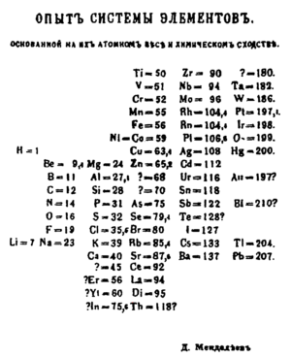
Mendeleev’s Periodic Table
He called his chart the “periodic” table.

Slide 3
Mendeleev’s Periodic Table
In order for similar elements to line up, Mendeleev left gaps in his chart.
Mendeleev stated these were undiscovered elements. He made predictions about these undiscovered elements based on the other elements in the same row.
By 1886, these elements (scandium, gallium, and germanium) were discovered and their properties closely matched his predictions.

Slide 4
Properties of Some Elements Predicted By Mendeleev

Slide 5
Mendeleev has Unresolved Issues
With the discovery of Mendeleev’s predicted elements, most chemists were persuaded to accept his table. However, there were two issues unresolved by his table.
What caused elements to have similar properties?
Why were there certain cases when a heaver element had to be placed in front of a light element so properties would line up? (Te and I)

Slide 6
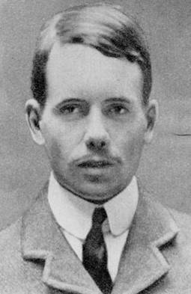
Moseley and the Periodic Table
Henry Moseley (1911) – discovered technique to determine nuclear charge of atom.
He called this the atomic number.
Every element had its own unique atomic number.
When Moseley arranged elements by increasing atomic number, the inconsistencies disappeared.

Slide 7
Modern Periodic Table
Periodic Law – when elements are arranged by increasing atomic numbers, elements with similar chemical and physical properties occur at regular intervals.
Today the periodic table arranges elements by groups and periods.
Group – vertical column of elements
also known as families
Period – horizontal row of elements

Slide 8
Changes in the Periodic Table
There have been significant changes to the periodic table since Mendeleev created his chart.
Noble Gases – elements that make up group 18. Include He, Ne, Ar, Kr, Xe, and Rn.
Extremely unreactive gases.
Very stable elements that will not combine with other atoms in nature.

Slide 9
Changes in the Periodic Table
(b) Lanthanide series – elements 58-71
Also called rare earth elements since they are hard to identify and separate.
These elements are part of period 6.
Actinide series – elements 90-103
Most are synthetic and all are radioactive.
These elements are part of period 7.

Slide 10
Outcome Sentences
After reflecting on today’s lesson, complete three of the sentence starters in your chemistry journal entry for today.
Sentence Starters
I’ve learned…
I was surprised…
I’m beginning to wonder…
I would conclude…
I now realize that…
Notes:
10

