Slide 1
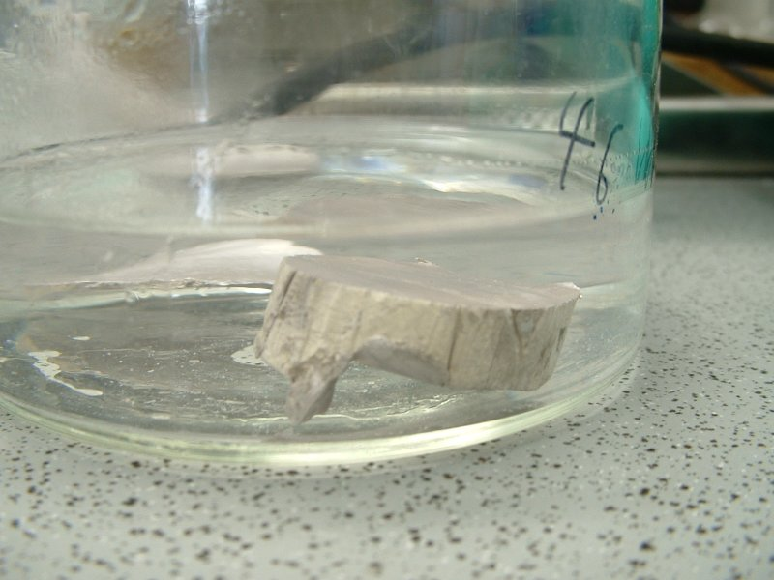
Properties of Subgroups
Elements of the same group have similar physical and chemical properties

Slide 2
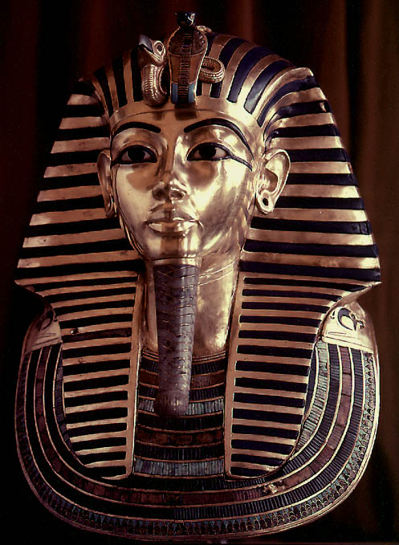
Properties of Metals
Good conductors of heat and electricity
Malleable
Ductile
Have luster (shine)

Slide 3
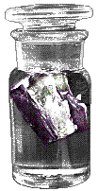
Alkali Metals
1 valence electron
Soft and shiny
Are NEVER found pure in nature (always bonded to another element)
VERY REACTIVE!!
React violently with water
Potassium, K reacts with water and must be stored in kerosene

Slide 4
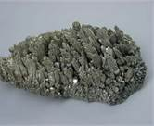
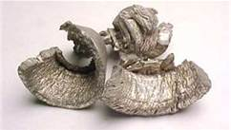
Alkaline Earth Metals
2 valence electrons
Less reactive than alkali metals
Not found pure in nature
The word “alkaline” means “basic”
Calcium (Ca)
Magnesium (Mg)

Slide 5
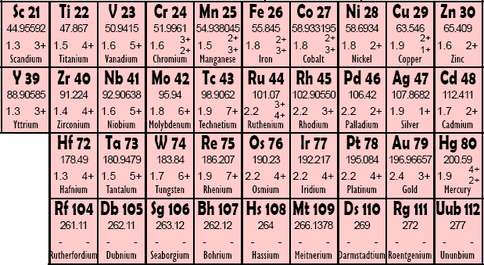
Transition Metals
Have all the properties of metals
Number of valence electrons varies
Charge of the element varies
Mercury, Hg, is the only metal that exists as a liquid at room temperature

Slide 6
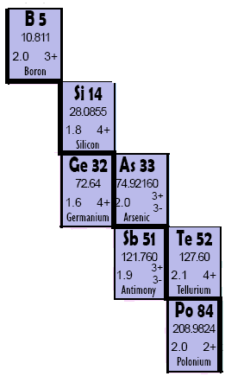
Properties of Metalloids
They have properties of both metals and nonmetals.
Less brittle than metals, more brittle than nonmetals.
Semiconductors of electricity
Metallic luster (shine)

Slide 7
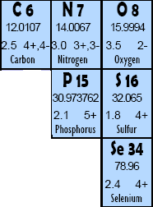
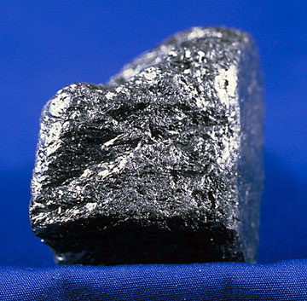
Nonmetals
Poor conductors of heat and electricity
Brittle
Majority are a gas at room temperature
Carbon, the graphite in “pencil lead” is a great example of a nonmetallic element.

Slide 8
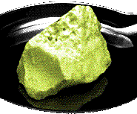
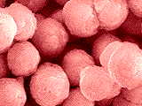
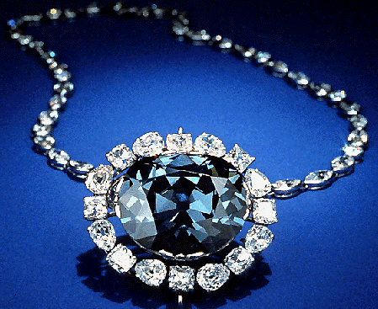
Examples of Nonmetals
Microspheres of phosphorus, P, a reactive nonmetal
Sulfur, S, was once known as “brimstone”
Graphite is not the only pure form of carbon, C. Diamond is also carbon; the color comes from impurities caught within the crystal structure

Slide 9
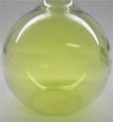
Halogens
7 valence electrons
Never found pure in nature (always bonded to another element)
In their pure form are diatomic molecules (F₂, Cl₂, Br₂, and I₂)
Chlorine is a yellow-green poisonous gas

Slide 10
Noble Gases
8 valence electrons (except helium, which has only 2)
ONLY found pure in nature – they are chemically UNREACTIVE!!
Colorless and odorless.
Were among the last of the natural elements to be discovered
Neon gives a distinct reddish-orange glow when used in a low-voltage lamp

